Slide 1
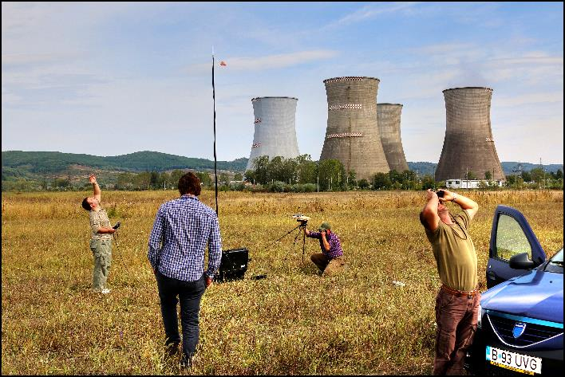
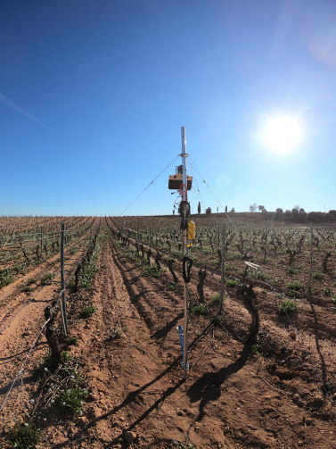
H2020 Copernicus CalVal Solution CCVS 27 May 2021

Slide 2
Scope of the CCVS project
Objective:
To define a holistic solution for all Copernicus Sentinel missions (either operational or planned) to overcome current limitations of Calibration and Validation (Cal/Val) activities.
Project duration: Dec. 2020 to Nov. 2022
Project website: https://ccvs.eu
Contact us: contact@ccvs.eu

Slide 3
Partners
Project lead:
14 Partners:
Advisory board:

Slide 4
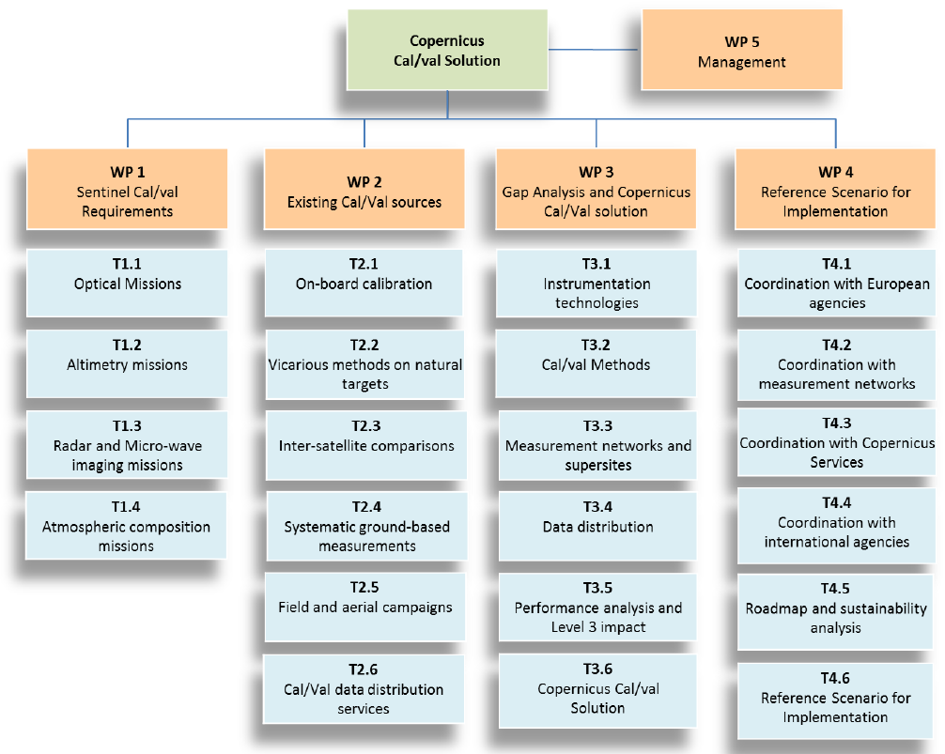
Overview

Slide 5
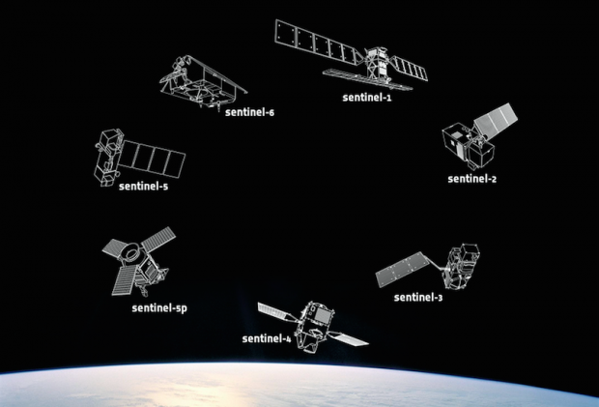
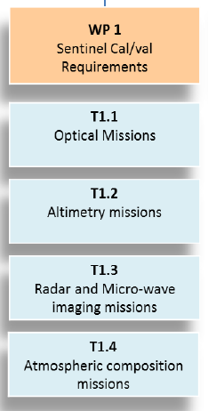
Sentinel Cal/Val Requirements
Listing all Sentinel L1 and L2 products (current and foreseen)
Establish calibration and validation needs for all Sentinel L1 and L2 products
Series of reports due end of May 2021

Slide 6
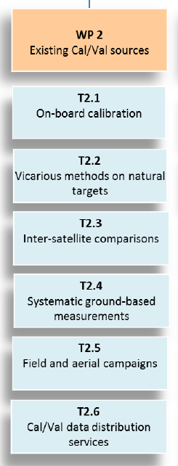
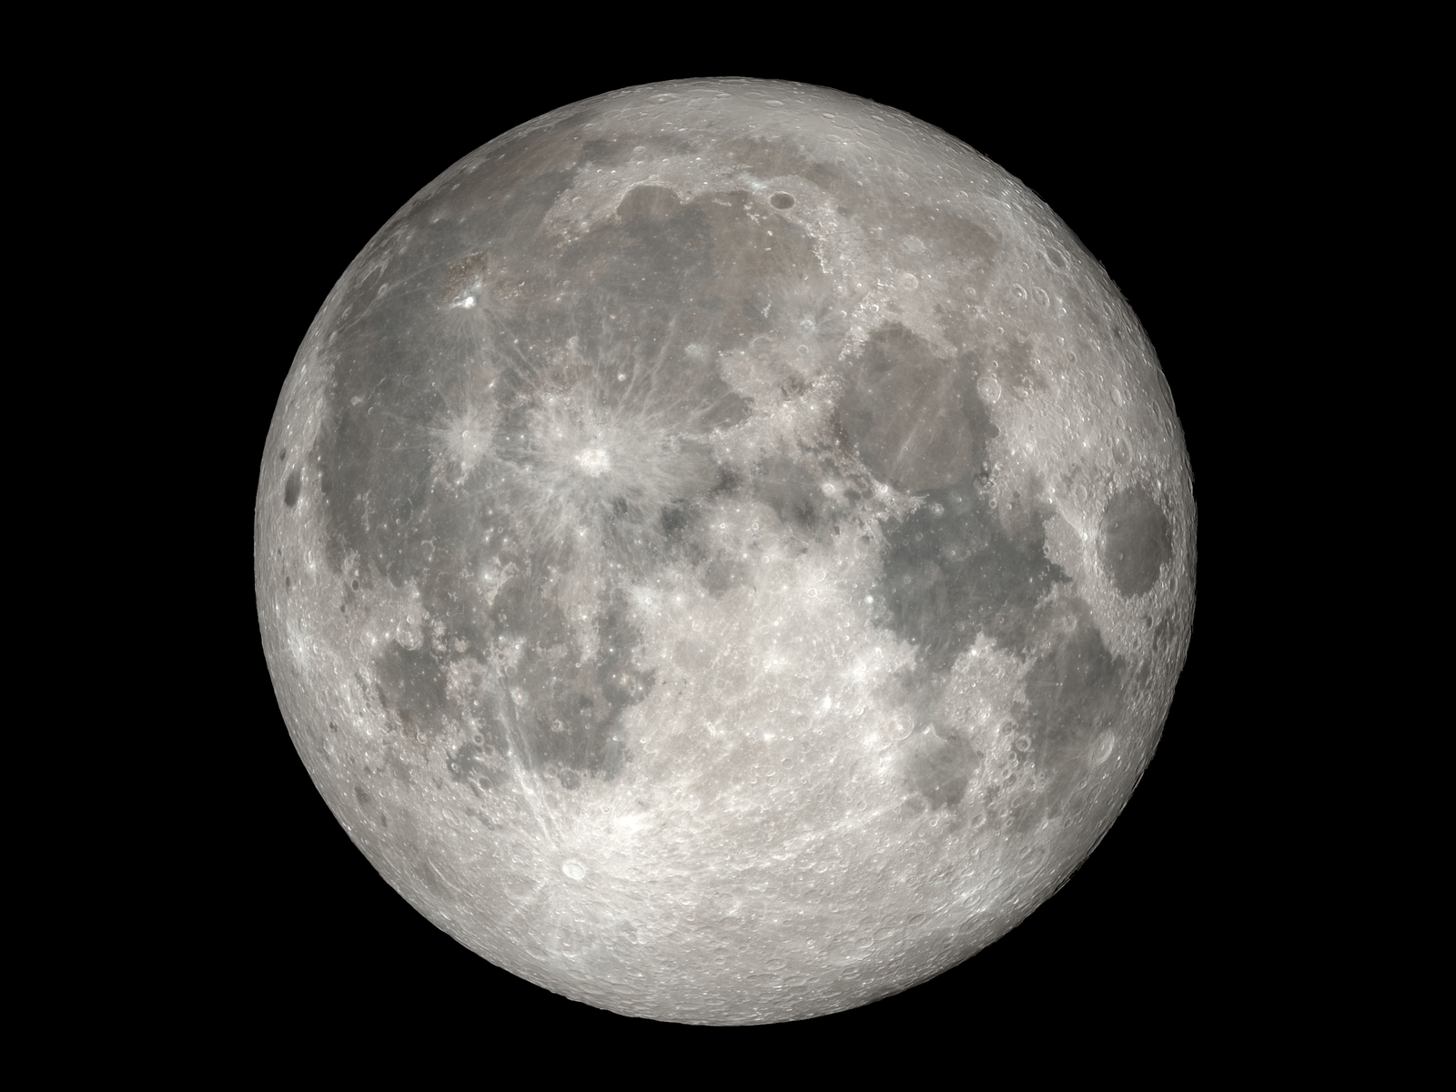
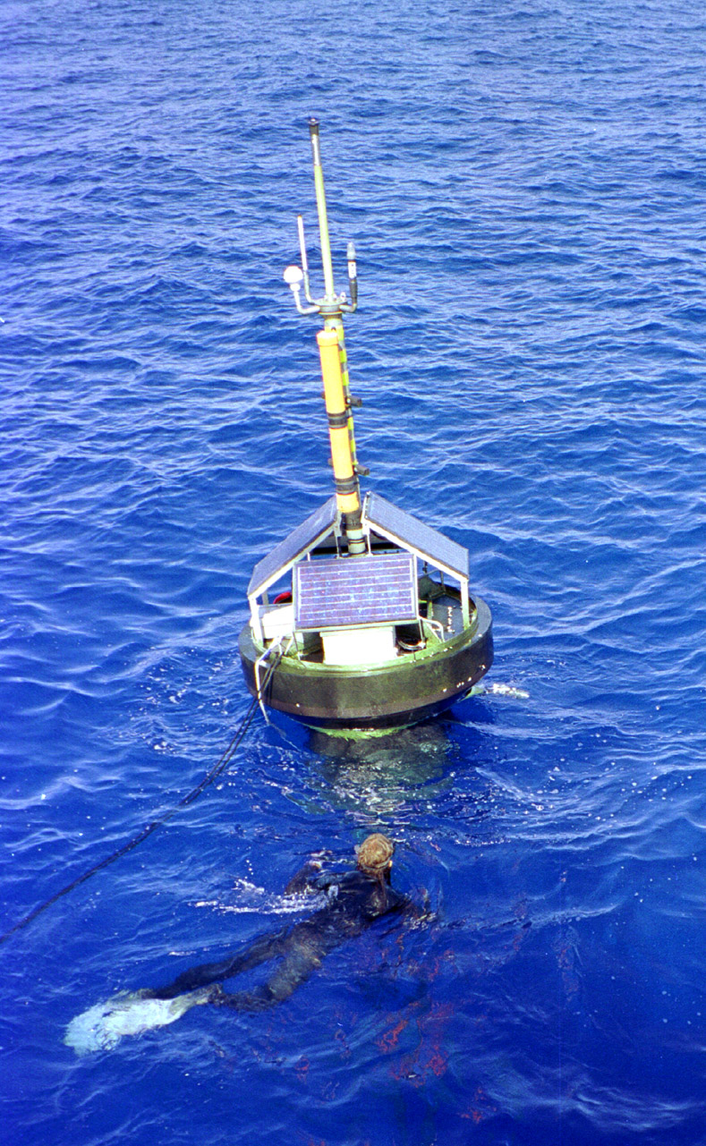
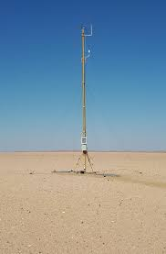
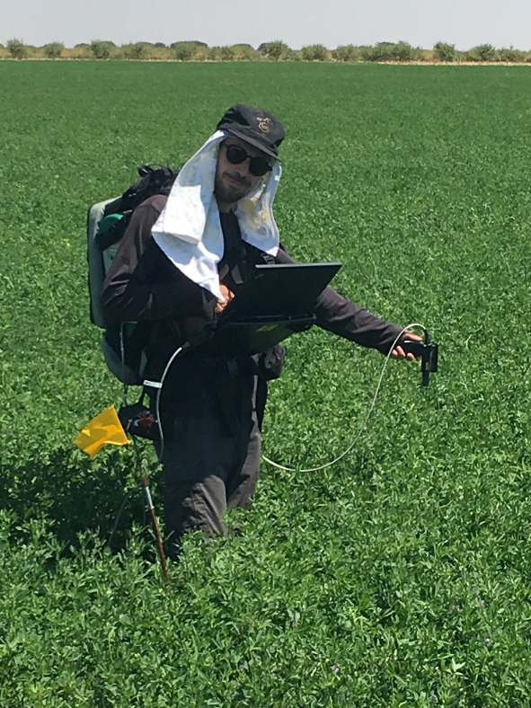
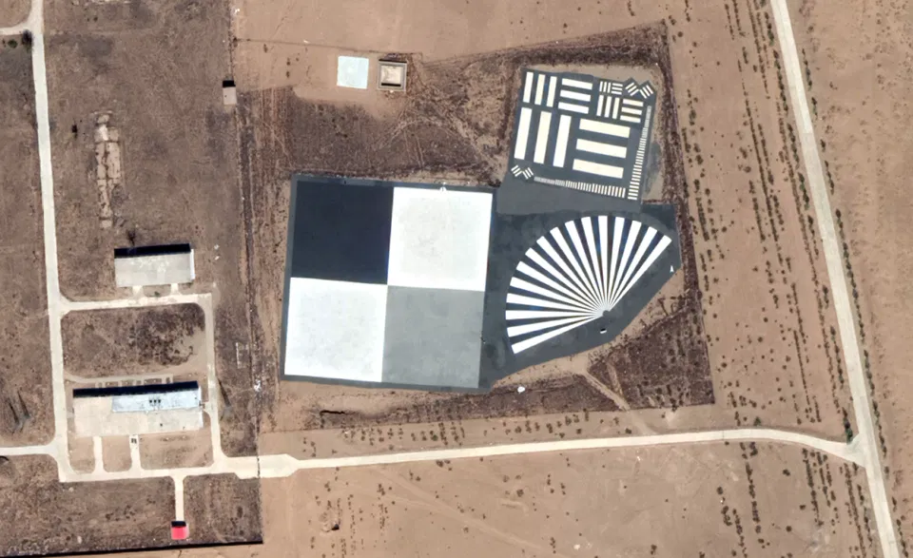
Existing Cal/Val Sources
Identify currently available Calibration and Validation sources
Establish constraints and limitations affecting these sources (technical and operational)
Identify perspectives on methods and emerging technologies
Series of reports due end of May 2021

Slide 7
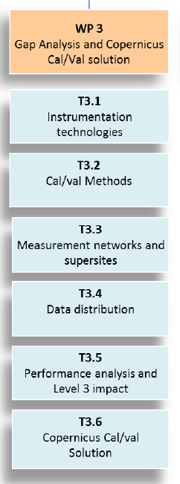
Gap Analysis & CCVS
Identify gaps in the current cal/val of Sentinel missions
Identify synergies and cross-Sentinel harmonisation needs
Define a network of core operational sites for the Sentinel missions
Define an operational organization and procedures for the cal/val activities of the Sentinel missions (data curation and distribution)
Analyse expected impact on uncertainty of Sentinel products and downstream products (including Level-3)
+ making existing networks FRM “compliant”

Slide 8
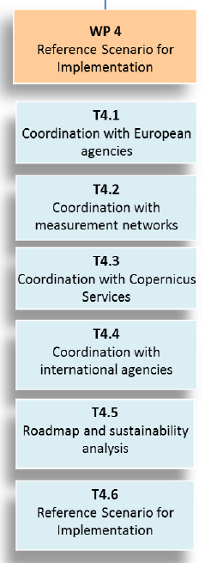
Reference Scenario for Implementation
Define a way forward for the implementation of the Copernicus Cal/Val solution
Establish roles and responsibilities among Copernicus stakeholders
Analyse sustainability and identify funding gaps
Define implementation schedule

Slide 9
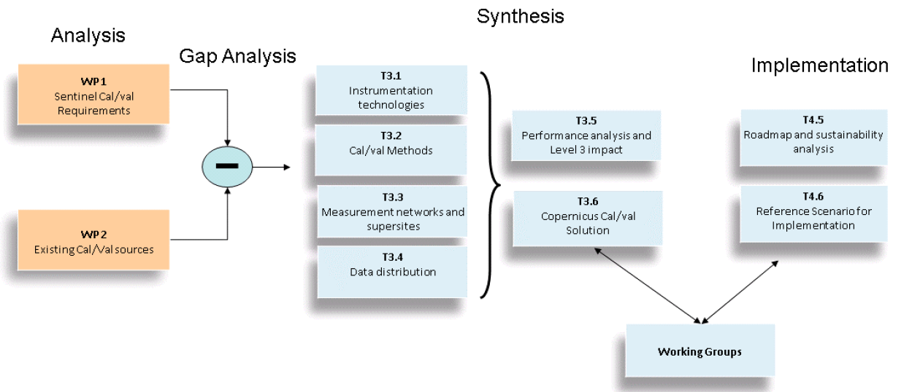
Implementation Summary
WG1 – Agencies, coordinated by ACRI-ST
WG2 - Measurement Networks, coordinated by University of TARTU
WG3 - Copernicus Services, coordinated by ACRI-ST
WG4 - International, coordinated by ACRI-ST

Slide 10
Where/How can LPV assist?
Be aware that this project is happening
Know where to look for information:
https://ccvs.eu
contact@ccvs.ed
Get involved! Join a working group / attend a workshop
Keep an eye out for follow-on programme funding to implement the CCVS

